Slide 1
PIP4004 - INTERNSHIP Review-2 Presentation SQL SERVER MANAGEMENT AND STANDARDISATION
Student Details
Name | CHANDRASHEKHAR K S
Roll No | 20211CSG0074
Section | 8CSD/CSG03-SEC10B
Batch No. | CSG-G10
Under the Supervision of,
Prof. Radhika Sreedharan
Assistant Professor
School of Computer Science and Engineering
Presidency University
Name of the Program: B-tech
Name of the HoD: Dr.Saira Banu Atham
Name of the Program Project Coordinator: Dr. vijay
Name of the School Internship/Project Coordinators: Mr. Md Ziaur Rahman /
Dr. Sampath A K / Dr. Abdul Khadar A

Slide 2
Content
About Company or Organization
Working domain or the technology
About your team and reporting Manager
Challenges Faced in Internship
Objectives of the work
Literature Review
Proposed System

Slide 3
Content
Abstract
Review Of Literature
Objectives
Problem Identification And Formulation Of Problem Statement
Road map, Impact And Advantages of the proposed work (Time line by Gantt Chart)
References
GitHub Link

Slide 4
About Company or Organization
Company Overview
Name: Inteva Products, LLC
Founded: 2008
Headquarters: Troy, Michigan, USA
Global Presence: Nearly 30 locations across North America, South America, Europe, and Asia
Employees: Approximately 8,000
Industry: Automotive
Website: www.intevaproducts.com

Slide 5
Product Portfolio
Interior Systems:
Instrument panels
Consoles
Door trim
Cockpits
Headliners
Closure Systems:
Door latches
Compartment latches
Strikers
Electronic actuators
Motors & Electronics:
Window lift motors
Seat motors
Actuators
Electronic control units

Slide 6
Clients and Market Presence
Client Base:
Over 50 customers in more than 40 countries
Major global automakers and regional Original Equipment Manufacturers (OEMs)
Industries Served:
Automotive
Commercial vehicle
Defense
Marine
Consumer and industrial sectors

Slide 7
Working domain or the technology
Overview of SQL Server Management
Definition: SQL Server Management involves administering databases to ensure security, performance, and accessibility.
Key Features:
Database administration (tables, views, procedures).
Data security through encryption and role-based access control.
Backup and recovery (point-in-time recovery).
High availability with Always On and Failover Clustering.
Performance tuning with Query Store and Profiler.
Cloud integration with Azure.

Slide 8
Importance of SQL Server Management
Ensures Data Integrity: Maintains accurate and consistent data.
Boosts Performance: Optimizes queries for fast application responses.
Enables Business Continuity: Prevents data loss with backups and high availability.
Scales with Growth: Handles increasing data and user demands.
Supports Security Compliance: Protects sensitive data from unauthorized access.

Slide 9
Standardization in SQL Server
Definition: Standardization sets consistent guidelines for database design and management.
Key Aspects:
Naming conventions for tables, columns, and procedures.
Use of appropriate data types for efficiency.
Coding standards for maintainability.
Backup policies for data protection.
Monitoring standards for database health.
Importance:
Streamlines collaboration and troubleshooting.
Reduces human errors.
Simplifies scalability and maintenance.

Slide 10
Practical Tasks During Internship
Database Backup & Recovery: Set up automated backups and test recovery plans.
Performance Tuning: Analyze and optimize slow queries.
User Management: Assign roles and permissions securely.
Monitoring & Alerts: Configure alerts for real-time database health tracking.
Standardization Implementation: Create templates for stored procedures, naming conventions, and enforce best practices.

Slide 11
About your team and reporting Manager
IT Infrastructure Support Overview
Global & Local IT Support:
Office Services:
Installation, support, and maintenance of end-user devices (computers, laptops, printers, etc.)
Shopfloor Services:
Support for shopfloor devices (control panels, handheld scanners, barcode printers, etc.)
Systems:
Installation, support, and maintenance of servers (File/Print, Email, Application, Database)

Slide 12
IT Infrastructure & Support Functions
Core IT Functions:
Network:
LAN, WAN, internet connections, remote access, and third-party network support
Security:
System, network, mobile device security, antivirus protection, firewalls
Business Continuity:
Backup/Restore, Disaster Recovery, monitoring
Communications:
PBX, telephone/mobile communications, VoIP, teleconferencing services
Service Desk / Help Desk:
Incident registration, escalation, and resolution

Slide 13


Core Database Administrator Team
Kottapalli, Venugopal
Global IT Operations Analysis & Control Manager
Doddasiddavannahally, Pradyothana
Team Manager - DBA / PMO
Pulikonda, Sreenivasulu
Database Administrator
PS
Chandrashekhar K S
Database Administrator(Intern)

Slide 14
Challenges Faced in Internship
Challenges in Searching for an Internship
1. Finding the Right Opportunities:
Competition: High competition for popular roles.
Limited Availability: Some fields have fewer internship opportunities.
Application Process: Time-consuming with tailored resumes and cover letters for each application.
2. Cracking the Interview:
Technical Tests: Coding assessments can be intimidating.
Behavioral Questions: You must demonstrate teamwork, problem-solving, and conflict resolution.
Nervousness: The pressure to perform can affect confidence and performance.
3. Adjusting to the Team:
Work Culture: Adapting to different workplace environments and dynamics.
Team Communication: Learning to collaborate with varying communication styles.
Technical Environment: Quickly adapting to new tools and technologies.

Slide 15
SQL Server Management
1. Database Creation & Configuration:
Setting up databases to store structured data.
Ensuring proper schema and structure for efficiency.
2. Backup and Recovery:
Implementing regular backup schedules to prevent data loss.
Ensuring a recovery plan is in place for system failures.
3. Security Management:
Configuring user access, roles, and permissions.
Securing sensitive data through encryption and authentication methods.
4. Performance Optimization:
Monitoring performance and optimizing slow queries.
Managing indexing, query optimization, and system resource utilization.

Slide 16
SQL Server Standardization
1. Naming Conventions:
Consistent naming for tables, columns, and procedures to ensure clarity and maintainability.
2. Database Design Standards:
Adhering to best practices in data types, normalization, and relationships to reduce redundancy.
3. Code and Query Standards:
Ensuring SQL code is written in an efficient, standardized manner to improve maintainability and performance.
4. Compliance and Security Standards:
Following legal and regulatory guidelines for data security and privacy.
5. Automation:
Automating routine tasks (e.g., backups, updates) to reduce errors and save time.

Slide 17
SQL Server Standardization
1. Naming Conventions:
Consistent naming for tables, columns, and procedures to ensure clarity and maintainability.
2. Database Design Standards:
Adhering to best practices in data types, normalization, and relationships to reduce redundancy.
3. Code and Query Standards:
Ensuring SQL code is written in an efficient, standardized manner to improve maintainability and performance.
4. Compliance and Security Standards:
Following legal and regulatory guidelines for data security and privacy.
5. Automation:
Automating routine tasks (e.g., backups, updates) to reduce errors and save time.

Slide 18
Title : SQL Server Management and Standardization Abstract:
The management and standardization of SQL Server environments are critical for ensuring efficient database performance, security, and scalability. This project focuses on developing a comprehensive framework for managing SQL Server instances, optimizing database operations, and standardizing best practices across the organization. The proposed solution will provide automated tools for routine database management tasks, standardized configurations for performance optimization, and a clear roadmap for database governance. The impact of this project includes reduced administrative overhead, improved database performance, and enhanced security compliance.

Slide 19
Literature Review :
SQL Server management and standardization have been widely studied in the context of database administration. Research highlights the importance of automated tools, standardized practices, and efficient monitoring systems in managing SQL Server environments. Various studies emphasize the need for standardized configurations to prevent performance bottlenecks and ensure data integrity. Best practices in SQL Server management include regular backups, indexing strategies, and performance tuning, which form the foundation of this project.

Slide 20
Proposed System
The proposed framework for SQL Server standardization is designed to streamline operations and improve consistency across all SQL Server instances. The key components of the framework are:
Standardized Installation Process: A step-by-step guide for installing SQL Server instances with predefined configurations for memory, storage, and network settings. This ensures uniformity across all instances.
Centralized Security Policies: Guidelines for configuring user access, permissions, and authentication across all SQL Server instances. This also includes encryption protocols and firewall settings.
Automated Backup and Recovery Plan: A set of automated tasks for performing regular backups, with defined retention policies and disaster recovery processes.
Performance Monitoring and Optimization: A set of standardized performance tuning procedures, including indexing strategies, query optimization techniques, and regular performance reviews.

Slide 21
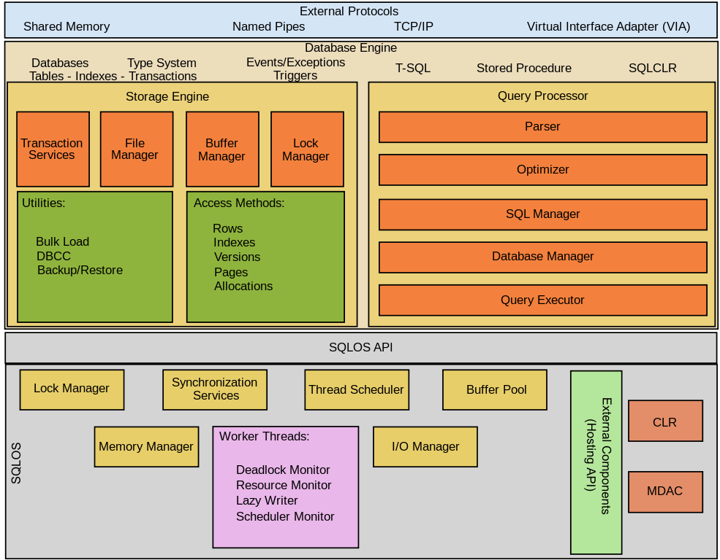

Slide 22
Objectives :
To develop a framework for efficient SQL Server management.
To standardize database configurations and practices.
To automate routine database maintenance tasks.
To improve database performance and scalability.
To ensure security compliance through standardized policies.

Slide 23
Problem Identification and Formulation of Problem Statement :
Managing SQL Server environments manually is time-consuming, error-prone, and lacks standardization. The absence of standardized practices leads to inconsistent performance, security vulnerabilities, and increased administrative efforts. This project aims to address these challenges by developing a standardized framework for SQL Server management, ensuring efficient operations, enhanced security, and optimized performance.

Slide 24

Roadmap, Impact, and Advantages of the Proposed Work (Timeline by Gantt Chart):
The project will be executed in multiple phases:
Research and Requirement Gathering (Week 1-2)
Design and Framework Development (Week 3-4)
Implementation of Management Tools (Week 5-6)
Standardization of Configurations (Week 7-10)
Testing and Optimization (Week 11-12)
Documentation and Final Review (Week 12-14)

Slide 25
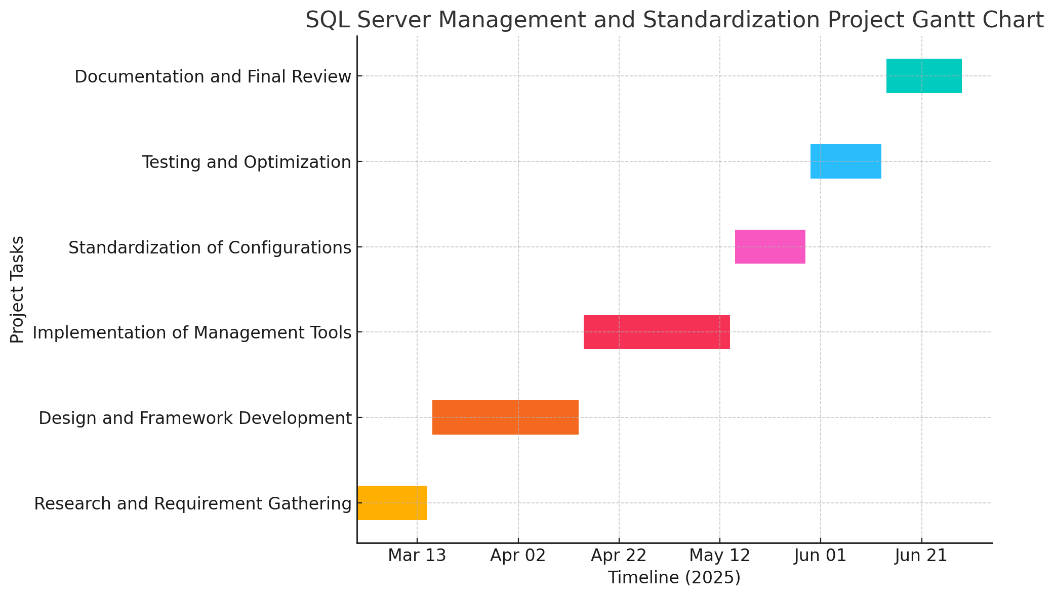
Gantt Chart :

Slide 26
Impact and Advantages:
Automated database management tasks reduce administrative efforts.
Standardized configurations ensure consistent performance
Enhanced security through standardized policies.
Improved scalability and reliability of SQL Server environments.
Comprehensive documentation for future reference and training.

Slide 27
References:
Microsoft SQL Server Documentation.
Best Practices for SQL Server Management by Redgate.
Database Administration: The Complete Guide by Craig S. Mullins.
Research papers on SQL Server standardization and performance tuning.

Slide 28
Github Link
https://github.com/ChandrashekharkS/Internship_Inteva.git

Slide 29
Q&A

Slide 30
Thank you !!

